Slide 1
Describing Motion with Equations Notes

Slide 2
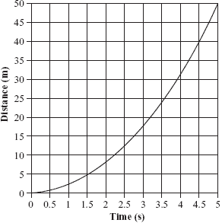
Preview
d= v_{average} * t
v_{average} = d/t

Slide 3
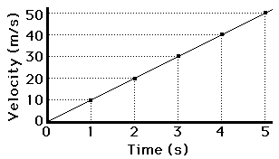
Preview
From the labs
Slope of the time = acceleration
so…
a = v_{f} - v_{i} /t
We can also get: v_{average} = v_{f} + v_{i} /2

Slide 4
Kinematics Equations:
d = v_{i}t + ½ at²
v_{f} = v_{i} + at
v_{f}² = v_{i}² + 2ad
d = [(v_{i} + v_{f})/2] * t
d = displacement
t = time
v_{i} = initial velocity
v_{f} = final velocity
a = acceleration

Slide 5
Strategies for solving problems
1. Construct an informative diagram of the physical situation.
2. Identify and list the given information in variable form.
3. Identify and list the unknown information in variable form.
4. Identify and list the equation which will be used to determine unknown information from known information.
5. Use appropriate algebraic steps to solve for the unknown variable.
6. Plug in the known information to solve problem.
7. Check your answer to insure that it is reasonable and mathematically correct.

Slide 6
Example A
Ima Hurryin is approaching a stoplight moving with a velocity of +30.0 m/s.
The light turns yellow, and Ima applies the brakes and skids to a stop.
If Ima's acceleration is -8.00 m/s², then determine the displacement of the car during the skidding process.
Note that the direction of the velocity and the acceleration vectors are denoted by a + and a - sign.

Slide 7

Diagram:
Given:
Unknown:
d = ?
v_{i} = +30.0 m/s
v_{f} = 0 m/s
a = - 8.00 m/s²

Slide 8
Equation:
v_{f}² = v_{i}² + 2ad
Solve for unknown variable:
d = (v_{f}² – v_{i}² )/ 2a
Plug in known information to solve:
d = (v_{f}² – v_{i}² )/ 2a
d = (0 m/s) ² – 30.0 m/s)² )/ (2*(-8.00 m/s²)
d = -900 m²/s² / -16.0 m/s²
d = 56.3 m
Is the answer reasonable?

Slide 9
Example B
Ben Rushin is waiting at a stoplight.
When it finally turns green, Ben accelerated from rest at a rate of a 6.00 m/s² for a time of 4.10 seconds.
Determine the displacement of Ben's car during this time period.

Slide 10

Diagram:
Given:
v_{i} = 0 m/s
t = 4.10 s a = 6.00 m/s²
Unknown:
d = ?

Slide 11
Equation:
d = v_{i}t + ½ at²
Solve for unknown variable: (already done)
d = v_{i}t + ½ at²
Plug in known information to solve:
d = v_{i}t + ½ at²
d = (0 m/s * 4.10 s) + (½ * 6.00 m/s² * (4.10 s) ²)
d = 0 m + 50.43 m
d = 50.43 m
Is the answer reasonable?

